Slide 1
Deep fake
Classifier that can distinguish between real and fake images.

Slide 2
Team members
Hemanth Kumar Bola – Data loading and visualization – Exploratory Data Analysis (EDA)
Chandini Marrapu – Data preprocessing using ImageDataGenerator – Model architecture design and implementation
Harika Devi Alla – Model training – Visualization of accuracy and loss metrics
Deepika Panjala – Model evaluation on test set – Confusion matrix and final performance analysis

Slide 3
INTRODUCTION
Deepfakes manipulate existing content by swapping one person’s face with another. Deepfakes can be extremely convincing and deceptive, making it difficult to tell real from fake.
They pose serious risks in:
Media and Journalism – spreading misinformation
Politics – fake speeches, altered public appearances
Cybersecurity – impersonation and identity fraud
Project Objective: To develop a Convolutional Neural Network (CNN) based image classifier that can accurately distinguish between real and fake images — thus providing a tool to detect and combat the misuse of deepfake technology.

Slide 4
DATASET DESCRIPTION
The dataset is publicly available and can be accessed at: https://www.kaggle.com/datasets/manjilkarki/deepfake-and-real-images
Dataset Name: DeepFake and Real Images
Source: Kaggle (Created by Manjil Karki)
Purpose: Designed to train and evaluate models that can distinguish between authentic and manipulated facial images.
The dataset contains a substantial number of images in each category, providing a balanced set for training and evaluation.
The dataset is divided into training, validation, and test sets to facilitate model development and evaluation.

Slide 5
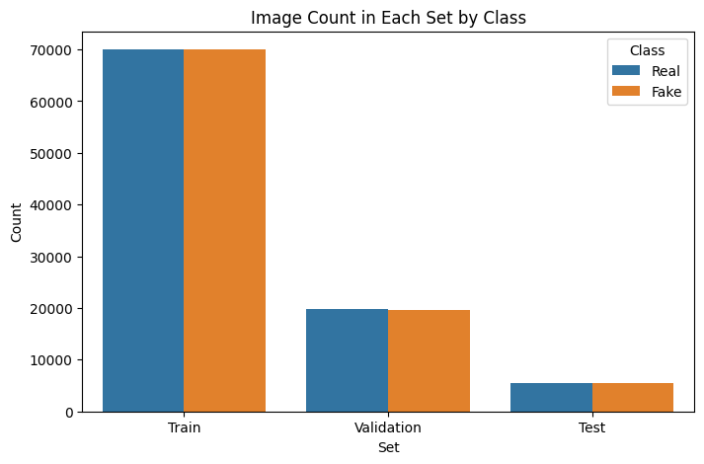
EXPLORATORY DATA ANALYSIS

Slide 6
DATA PREPOCESSING
Preparing the image data in a format suitable for training a Convolutional Neural Network (CNN) by applying transformations and splitting it into appropriate sets.
All input images are resized to 128x128 pixels using the target_size parameter in ImageDataGenerator.
Ensures uniform dimensions across all images, which is essential for CNN input layers.
Using flow_from_directory():
Training Set:
140,002 images
With real-time data augmentation
Validation Set:
39,428 images
Used to monitor model performance after each epoch
Test Set:
10,905 images
Final evaluation after model training
Shuffling Disabled (shuffle=False) to preserve image-label order for predictions

Slide 7
CNN MODEL ARCHITECTURE
Input → Conv2D (ReLU) → MaxPooling → Conv2D (ReLU) → MaxPooling → Flatten → Dense (ReLU) → Dense (Sigmoid)
Conv layers for feature extraction
ReLU for non-linearity
Sigmoid for binary classification
Why This Architecture?
Simple yet effective for binary image classification
Efficient on medium-sized datasets (~190K images)
Easily extendable with more layers or pretrained models for improvement

Slide 8
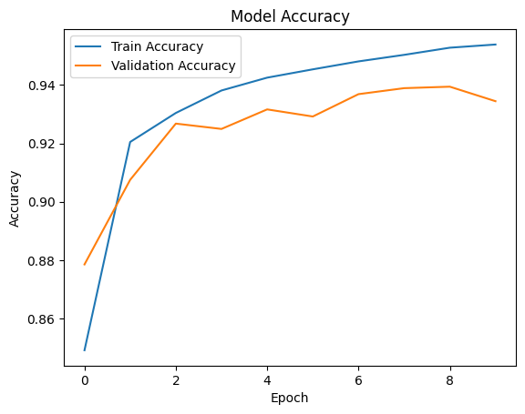
TRAINING AND EVALUATION
Accuracy Plot :
Steady increase in both training and validation accuracy across epochs
Training Accuracy: Reaches ~95%
Validation Accuracy: Peaks around ~94%
Suggests effective learning and minimal overfitting

Slide 9
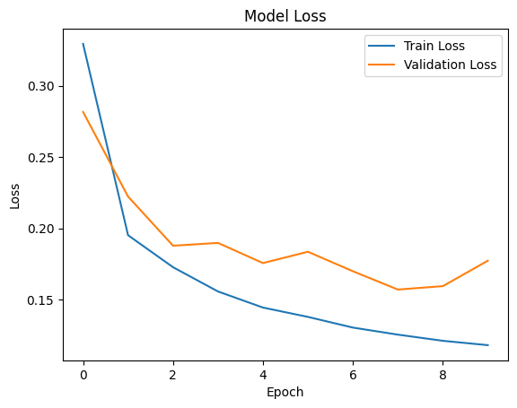
Consistent decrease in training loss over epochs
Validation loss shows minor fluctuations but trends downward overall
Indicates stable generalization to unseen data
Interpretation:
The model shows strong convergence and good generalization.
No major signs of overfitting or underfitting.
Ideal base for further tuning or deploying.

Slide 10
Results – model evaluation on test data
Precision: Model is more confident in detecting Fake images (92%)
Recall: Model captures Real images more completely (93%)
F1-Score: Balanced performance across both classes
Model shows strong accuracy and balanced generalization across classes.
Slightly more conservative in marking images as Fake (higher precision than recall).
Very useful in real-world applications where false positives (misclassifying real as fake) are more tolerable than false negatives.

Slide 11
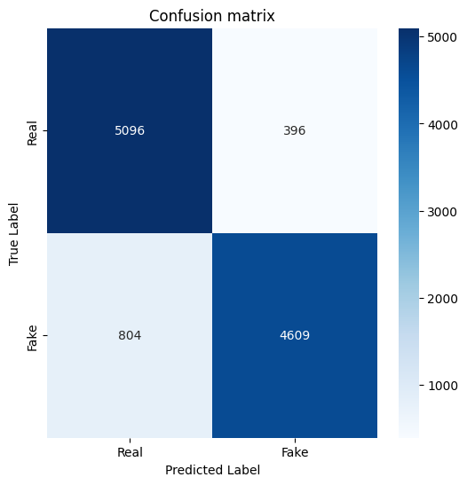
CONFUSION MATRIX ANALYSIS
True Positives (TP): 4609 Fake images correctly identified
True Negatives (TN): 5096 Real images correctly classified
False Positives (FP): 396 Real images misclassified as Fake
False Negatives (FN): 804 Fake images missed (classified as Real)

Slide 12
CHALLENGES AND FUTURE IMPROVEMENTS
Visual Similarity Between Classes: Deepfake images often appear nearly identical to real images, especially to the naked eye and even to basic models.
Overfitting Risk: Minor overfitting signs as training accuracy slightly exceeds validation accuracy after certain epochs.
Future Work and Enhancements
Use of Transfer Learning:
Incorporate pretrained models like VGG16, ResNet, or EfficientNet for improved feature extraction and accuracy.
Image Augmentation Expansion:
Use more advanced techniques (e.g., brightness shifts, blurs) to make the model more robust.
Model Optimization:
Experiment with regularization (Dropout, L2) and tuning learning rate for better generalization.

